Slide 1
combatting misinformation With Media LIteracy
National & State Libraries Australasia, Australian Library & Information Association Webinar
Sora Park, Professorial Research Fellow, University of Canberra
sorapark sora.park@canberra.edu.au
Barbara Walsh, Associate Professor, University of Canberra
barbara.walsh@canberra.edu.au

Slide 2
What is misinformation?
An umbrella term to cover all kinds of potentially harmful false, misleading or deceptive information.
Australian Communications & Media Authority. (2020). Misinformation and news quality on digital platforms in Australia: A position paper to guide code development. Canberra: ACMA.

Slide 3
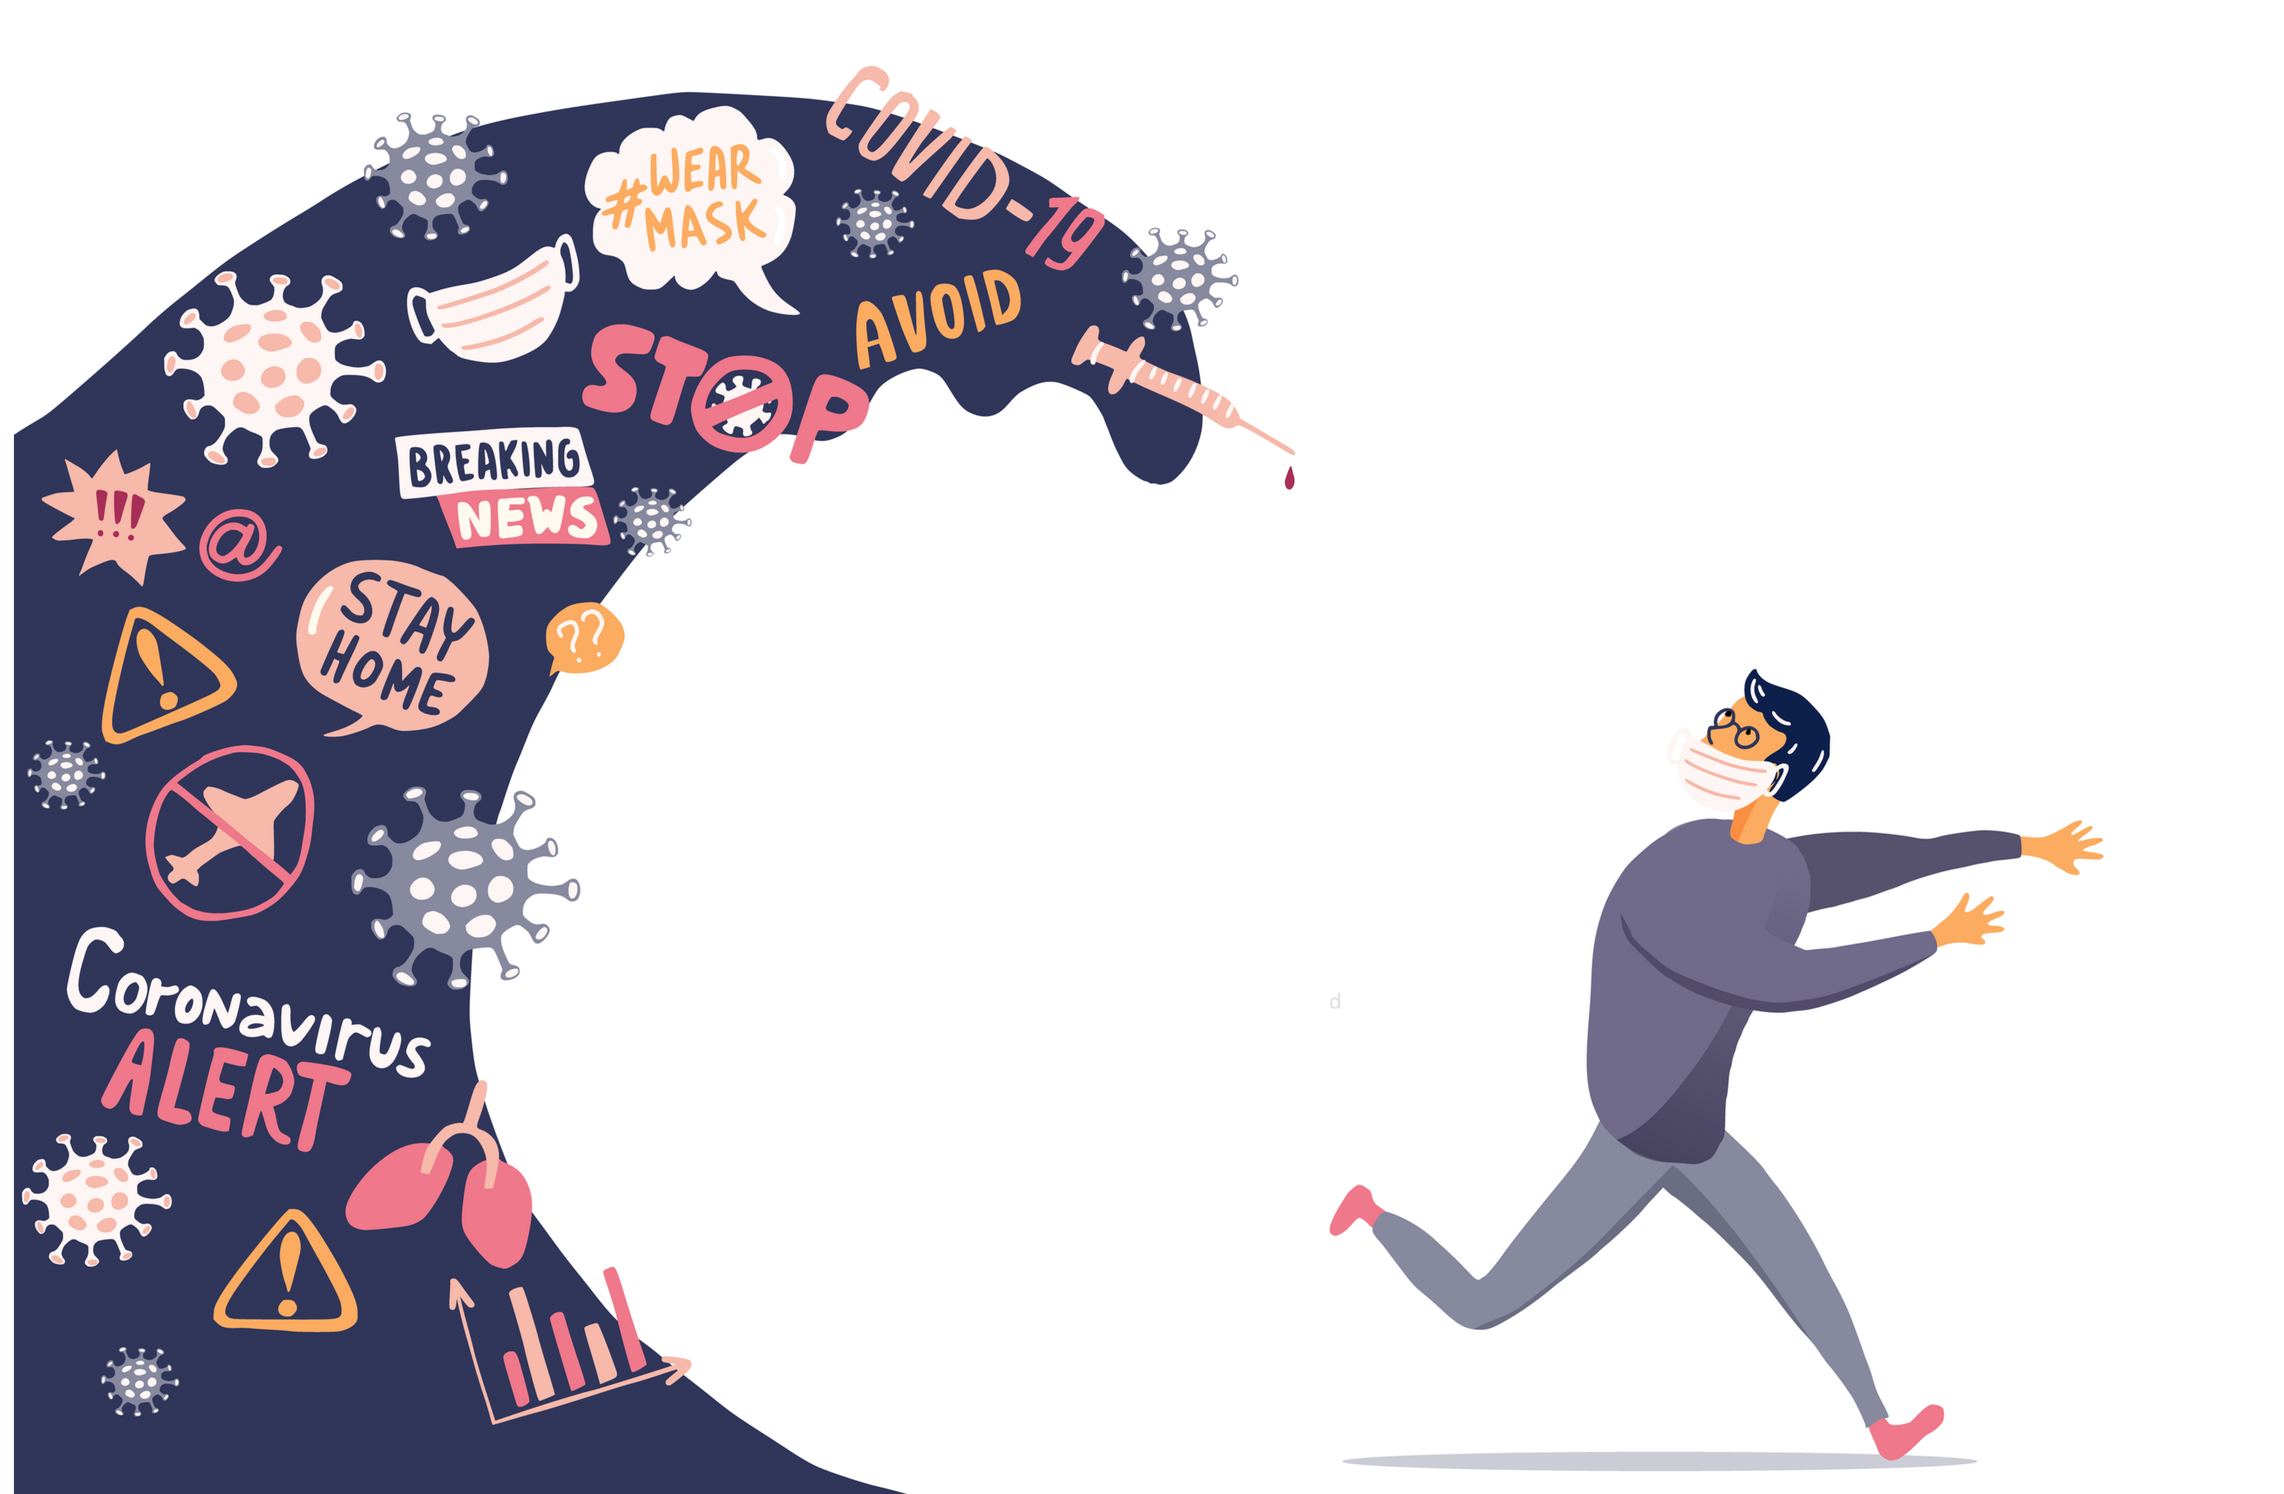
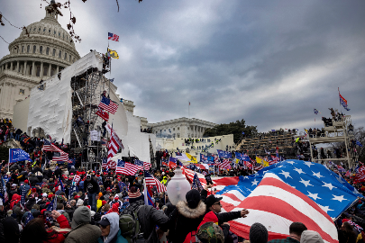
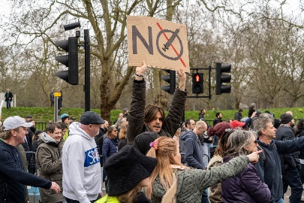
Real Life Impact
#StopTheSteal
Anti-Vaccine
https://www.justsecurity.org/74622/stopthesteal-timeline-of-social-media-and-extremist-activities-leading-to-1-6-insurrection/
https://journals.plos.org/plosone/article/comment?id=10.1371/annotation/dfa40344-56a7-4eb6-95b0-923fbf45377a

Slide 4
Experience of COVID-19 misinformation by platform
Park, S., McCallum, K., Holland, K., McGuinness, K., Lee, J., Fisher, C. & John, E. (2022). COVID-19: Australian News & Misinformation Longitudinal Study. Canberra: News Media Research Centre, University of Canberra. https://apo.org.au/sites/default/files/resource-files/2022-03/apo-nid316582.pdf

Slide 5
HIGHER CONCERN, LOWER EXPERIENCE, UNABLE TO DISCERN
Concerned about misinformation | 64 | 58
Experienced misinformation | 59 | 73
Don't know if I encountered misinformation | 23 | 17
Park, S., Fisher, C., McGuinness, K., Lee, J., K. & McCallum, K. (2021). Digital News Report: Australia 2021. Canberra: News & Media Research Centre. https://apo.org.au/node/312650

Slide 6
77% of adult Australians are unfamiliar with the term ‘media literacy’.
61% of Australians don’t feel confident they can take steps to identify misinformation.
Notley, T., Chambers, S., Park, S. & Dezuanni, M. (2021). Adult Media Literacy in Australia: Attitudes, Experiences and Needs

Slide 7
What is media literacy?
The ability to critically engage with media in all aspects of life. It is a form of lifelong literacy that is essential for full participation in society.

Slide 8
78%
Individuals should use common sense and learn to detect it themselves.
Social media or online platforms should be doing more to reduce the amount of misinformation.
76%
59%
It is the government’s responsibility to make sure the public is not exposed.
Park, S., McCallum, K., Holland, K., McGuinness, K., Lee, J., Fisher, C. & John, E. (2022). COVID-19: Australian News & Misinformation Longitudinal Study. Canberra: News Media Research Centre, University of Canberra.

Slide 9
Responses to misinformation
 | Z | Y | X | BB | 74+
I stopped paying attention to information shared by people I don’t trust | 30 | 30 | 30 | 38 | 43
I searched different sources to see whether it was accurate | 32 | 27 | 25 | 25 | 22
I started using more reputable information sources | 24 | 20 | 15 | 16 | 18
I discussed the information with other people I trust | 15 | 17 | 15 | 15 | 12
Park, S., McCallum, K., Holland, K., McGuinness, K., Lee, J., Fisher, C. & John, E. (2022). COVID-19: Australian News & Misinformation Longitudinal Study. Canberra: News Media Research Centre, University of Canberra.

Slide 10
The role of libraries
Delivery of life-long education
Local experts and intermediaries
Both formal and informal ways of learning
Training vs (ongoing) support
Notes:
The role of public institutions such as public libraries is critical in providing continuous life-long education for citizens. The importance of informal networks and intermediaries have been found in many studies, mainly from digital inclusion studies (Diaz et al, 2009; Powell, et al, 2010; Park, 2014). People’s behaviour in the adoption and use of a new technology is largely dependent on the social support groups that surround them. This was found to be true among Australian adults where most of their support in media use came from family and friends (Notley et al, 2021).
Local experts are those who people seek out for help, who have influence over the adoption of new technologies. The motivation to reap the benefits of digital engagement occurs at the local level of the non-user’s social environment, including the local community, workplace and neighbourhood, and close friends and family. In this context, libraries provide a critical infrastructure for the general public to acquire media literacy.

Slide 11
Media Literacy Intermediaries: Australian Library & Information Association Survey 2021
An online survey was administered via ALIA member networks from Thu 7 Oct to Fri 3 Dec 2021 (n=536)

Slide 12
Confidence and experience of helping members of the public

Slide 13
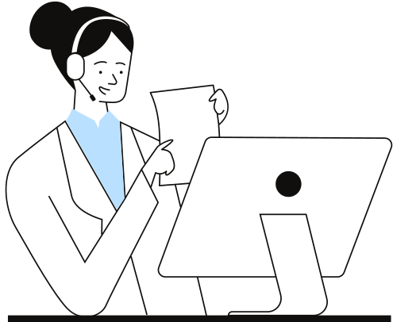
The most common activities patrons ask for help are
finding information online
general internet use and
using devices (smartphones/laptops & computers).
Older adults and family/parents are more likely to ask for help in general internet use, and using devices.
Young people are more likely to need help in finding information and using library resources.

Slide 14
Who is responsible for delivering media literacy education?
75%
40%
Secondary and senior schools
People themselves
73%
Libraries
27%
Community organisations
50%
Primary schools
20%
Universities or TAFE

Slide 16
Media Literacy for LIS Professionals
2 May – 17 June 2022
Flexible, self-paced, online short course
For those who teach media literacy to students and the public including Librarians, Teacher Librarians, other LIS professionals such as Library Technicians or Assistants
Digital Badge on completion

Slide 17
What will we cover?
3
Misinformation and how to identify it; factchecking and verification
4
Advertising and your personal data; identifying advertising from editorial
1
What is Media Literacy, and why does it matter?
5
Digital Citizenship: understanding influencer tactics; how we can all be everyday propagandists.
2
Understanding news and media bias
6
Staying Safe Online: information literacy and cyberbullying

Slide 18
Skills and Resources
Lateral reading and reverse image/video searches
Factchecking and verification
Separate fact from fiction, news from opinion, advertising from editorial
Introduction to open source resources, programs, games, activities for continuing education
Keeping yourself safe online
Critical thinking to help you understand and identify misinformation and media bias

Slide 19
Tailored to LIS Professionals
Content tailored to survey response
Relevant asynchronous discussions with peers
Focus on curating your own educational package
Guidance and direction on open-source, reputable media literacy educational organisations

Slide 20
Key Details
2 May – 17 June 2022
Students must be registered by Tuesday 26 April
ALIA Members: AUD$495
Non-ALIA Members: AUD$595
More info: ucmedialiteracy@canberra.edu.au

Slide 21
www.canberra.edu.au/nmrc
ucmedialiteracy@canberra.edu.au

